Slide 1
Week 15 Graph
Team Teaching for Data Structures and Algorithm 2021

Slide 2
Learning Objective
Students are able to understand the definition of Graph and its terminologies
Students are able to model the real world problems using Graph
Students are able to map and explain Graph Data Structure

Slide 3
Outlines
Graph and its history
Terms used in Graph
Example of Graph implementation
Graph Representation

Slide 4
Graph
Graph is used to represent discrete objects and its relation
Following image represents the roads and distance among the cities in Central Java
Notes:
Graf merupakan struktur matematik yang merepresentasikan relasi antar entitas di dunia nyata. *
(Sianipar, R.H., 2013, Java, Algoritma, Struktur Data dan Pemrograman GUI, Bandung : Informatika)

Slide 5
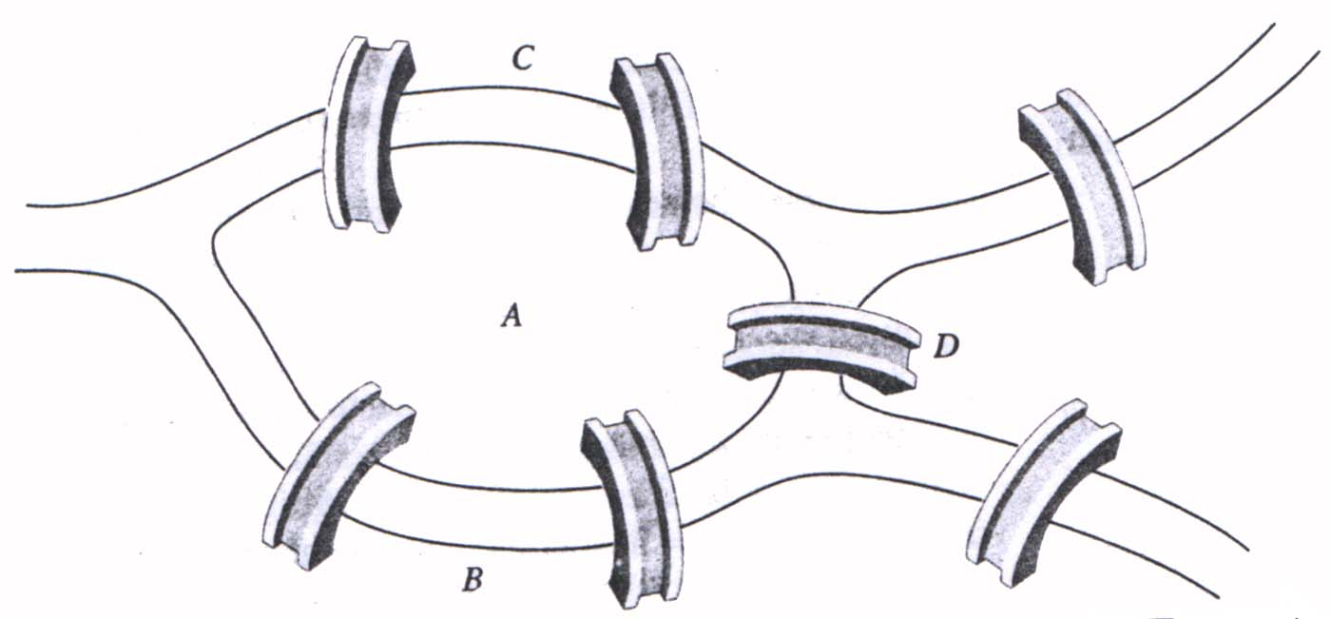
History of Graph
Königsberg bridge in 1973 M
Graph that represents Königsberg bridge:
vertex (points) → represents lands
edge (edge/ lines) → represents bridges
Can we go through each bridge only once and still go back to initial point ?
Notes:
Jembatan Konigsberg memiliki 7 jembatan untuk menghubungkan daratan C ke daratan A, daratan A ke daratan B, daratan A ke daratan D, daratan B ke daratan D dan daratan C ke daratan D.
A memiliki 5 sisi yang saling terhubung, B memiiliki 3 sisi yang saling terhubung, C memiliki 3 sisi yang saling terhubung, dan D memiliki 3 sisi yang saling terhubung.
Sehingga bentuk graph nya digambarkan pada sebelah kanan.
Bisakah melalui setiap jembatan tepat sekali dan kembali ke tempat semula? Jawabannya Tidak Bisa.
Untuk dapat dikunjungi masing-masing satu kali dan Kembali ke titik semula, jumlah jembatan harus
Sejarah teori Graph bermula saat ahli matematika Swiss Leonhard Euler memecahkan masalah jembatan Konigsberg. Masalah jembatan Konigsberg adalah teka-teki lama mengenai kemungkinan menemukan jalan setapak di tujuh jembatan yang membentang di sepanjang sebuah sungai bercabang yang melewati sebuat pulau tanpa melewati jembatan dua kali. Euler berpendapat tidak ada jalan semacam itu. Buktinya hanya mengacu pada susunan fisik jembatan, namun intinya dia membuktikan teorema pertama dalam teori Graph.

Slide 6
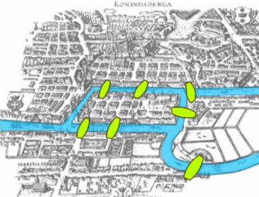
Graph HISTORY
7 bridges of Königsberg (1736)
Königsberg was a city in Germany, and the city was built around a river called the Pregel River

Slide 7
Graph HISTORY
The citizens of Königsberg spent their Sundays walking around town, enjoying their beautiful city
Challenge → walk across all of the seven bridges crossing the islands only once, without ever repeating a single bridge in the course of one’s walk.

Slide 8
Graph HISTORY
Finally, Leonhard Euler can solve the problem, by using a rule later called as Euler Path
Euler path is a path wherein we only visit each edge in the graph once, while Euler Circuit is a Eulerian path that is a cycle — we only visit every edge once, and we end on the exact same node that we started off on.
Euler Path basic rule:
The number of vertices of odd degree must be either zero or two.
And if there are two vertices with odd degree, then they are the starting and ending vertices.

Slide 9
Graph HISTORY
simplify
Vertex | Degree
A | 5
B | 3
C | 3
D | 3
Since there are 4 vertices with odd degree, then it is not Euler Path

Slide 10
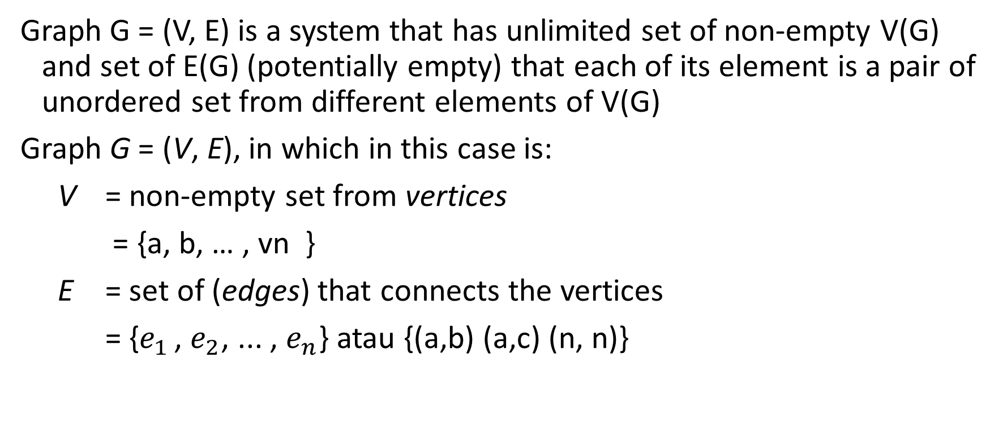
Definition of Graph
Graph G = (V, E) is a system that has unlimited set of non-empty V(G) and set of E(G) (potentially empty) that each of its element is a pair of unordered set from different elements of V(G)
Graph G = (V, E), in which in this case is:
V = non-empty set from vertices
= {a, b, … , vn }
E = set of (edges) that connects the vertices
= {$e_{1 }\text{,} e_{2}$, ... , $e_{n}$} atau {(a,b) (a,c) (n, n)}
Notes:
V merupakan himpunan tak kosong artinya tidak boleh kosong
Sedangkan E himpunan mungkin kosong artinya mungkin tidak ada sisinya
Maksudnya, sebuah Graf mungkin tidak memiliki garis tetapi harus terdiri dari minimal 1 titik
Pasangan tak berurut artinya penulisannya boleh dibolak-balik
Secara matematika, titik disimbolkan v1, v2, v3, dst atau a, b, c, dst atau 1, 2, 3, dst
Sedangkan garis yang mengubungkan titik v1 dengan v2 dituliskan dengan pasangan {v1, v2} atau lambang e1

Slide 11
Terms used in a Graph
Vertex / points
Dots in graph also known as vertex. Usually symbolized with circle.
Edge (Lines or sides or corners)
Line connectors that unites all the vertex inside the graph is called (edge)
Adjacency
2 Vertexes is adjacent if it is connected with one line / (edge).
Path
Path represents of a way from one point to another

Slide 12
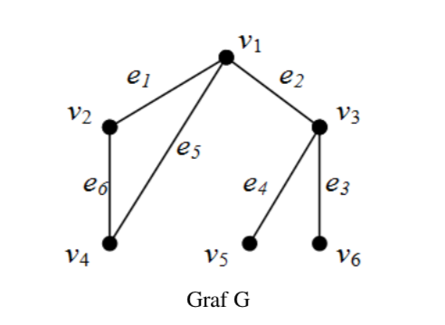
Example
Graph G
v1, v2, v3, v4, v5, v6 are vertexs
e₁, e₂, e₃, e₄, e₅, e₆ are lines
v1 is adjacent with v2, v3 and v4
v2 is not adjacent with v3, v5 and v6
Path from v4 to v6 are v4 → v2 → v1 → v3 → v6
Another path from v4 to v6 are v4 → v1 → v3 → v6
The shortest path indicates how close are the points to each other that is connected with a line

Slide 13
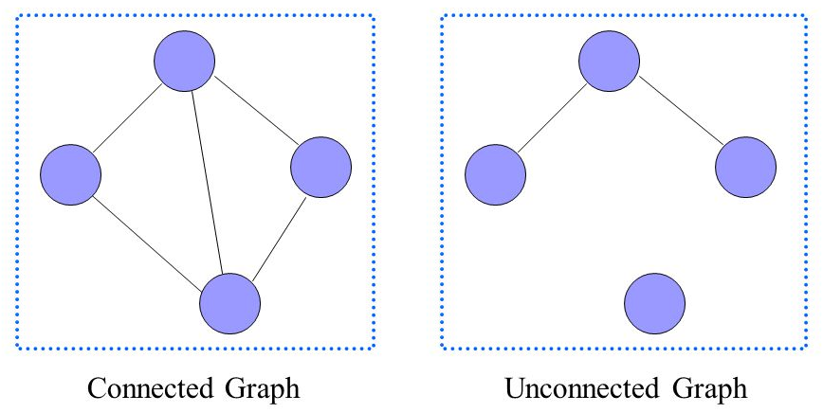
Terms used in a Graph
Connected
A connected graph will requires at least one edge that connects one vertex to each other. This image is an example of connected graph. While for the unconnected graph, the vertexes are not connected as a whole

Slide 14
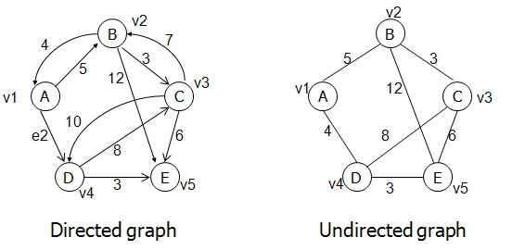
Terms used in a Graph
Directed Graph and Weighted Graph
Directed and weighted Graph is a graph with a line that connects the vertexes that has direction and weight

Slide 15
Terms used in a Graph
Degree, in-degree and out-degree
Degree of a vertex is the amount of lines are connected to that vertex
In-degree is a vertex in a directed graph that has some path refers to the vertex itself
Out-degree is a vertex in a directed graph that has some path refers from that vertex
Notated as d(v)
D_{in} (A) = 1
D_{out}(A) = 2
Notes:
D_{in} (A) = 1 (garis bernilai 4)
D_{out}(A) = 2 (garis bernilai 5 dan garis e2)

Slide 16
Graph Representation
Adjacency list
Adjacency list uses an array in linked list. This array will be used to store the vertex amount. The value of the linked list wil be used to store graph’s weight.
Adjacency matrix
Adjacency matrix is an 2D array with size V x V. Which V are the vertex’s amount of a graph. If adj[i][j] = 1, then it means that there is a line / edge from point i to point j.

Slide 17
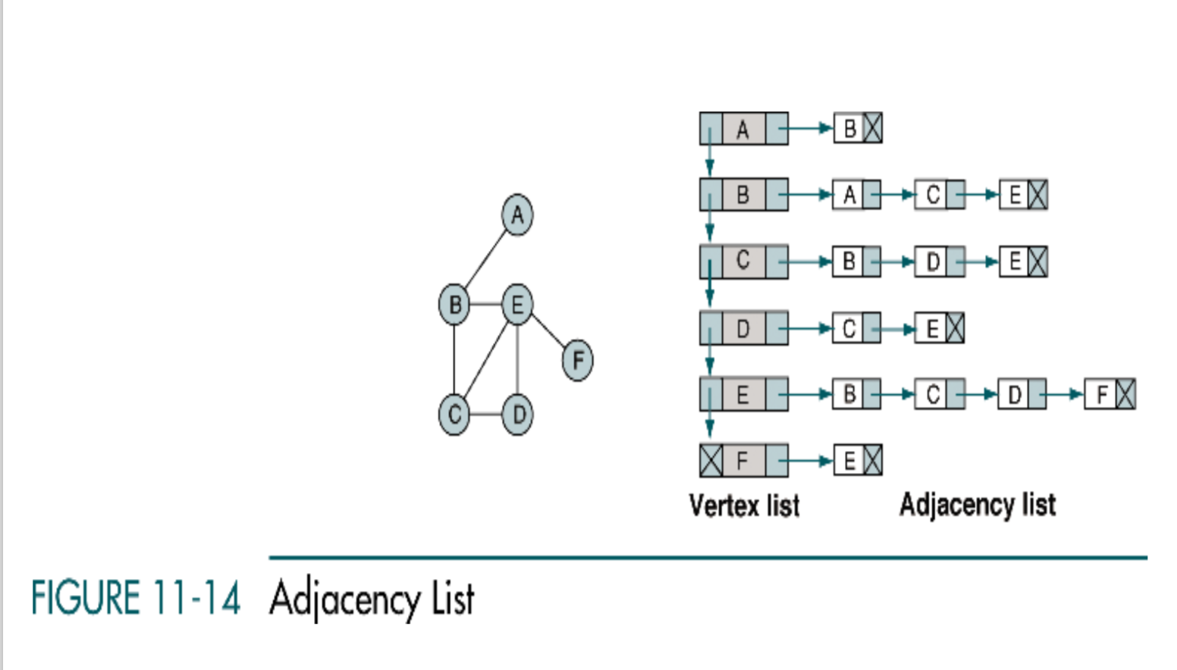
Adjacency list undirected graph

Slide 18
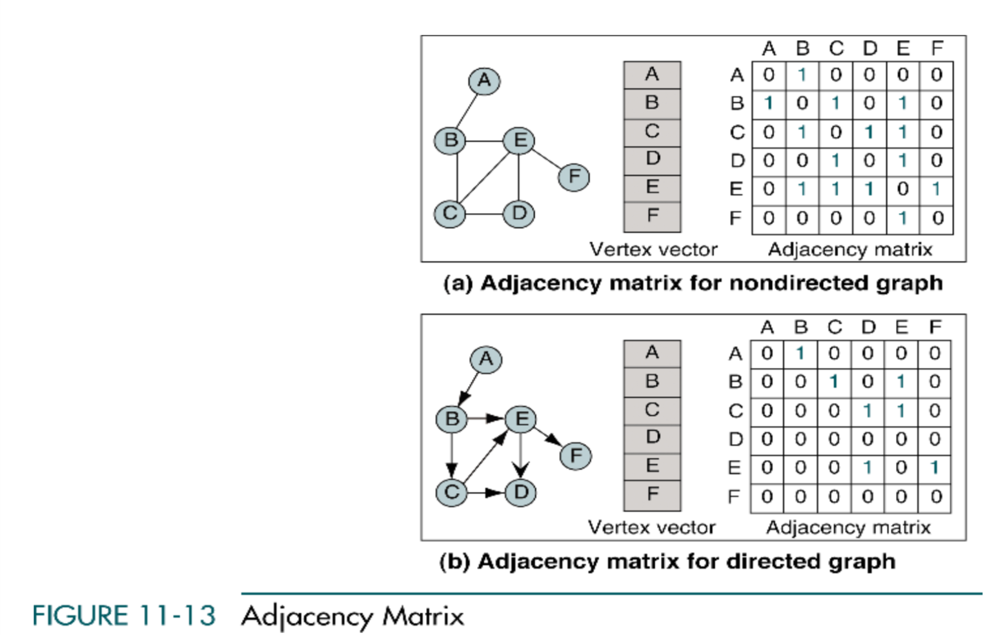
Graph and matrix adjacency directed graph

Slide 19
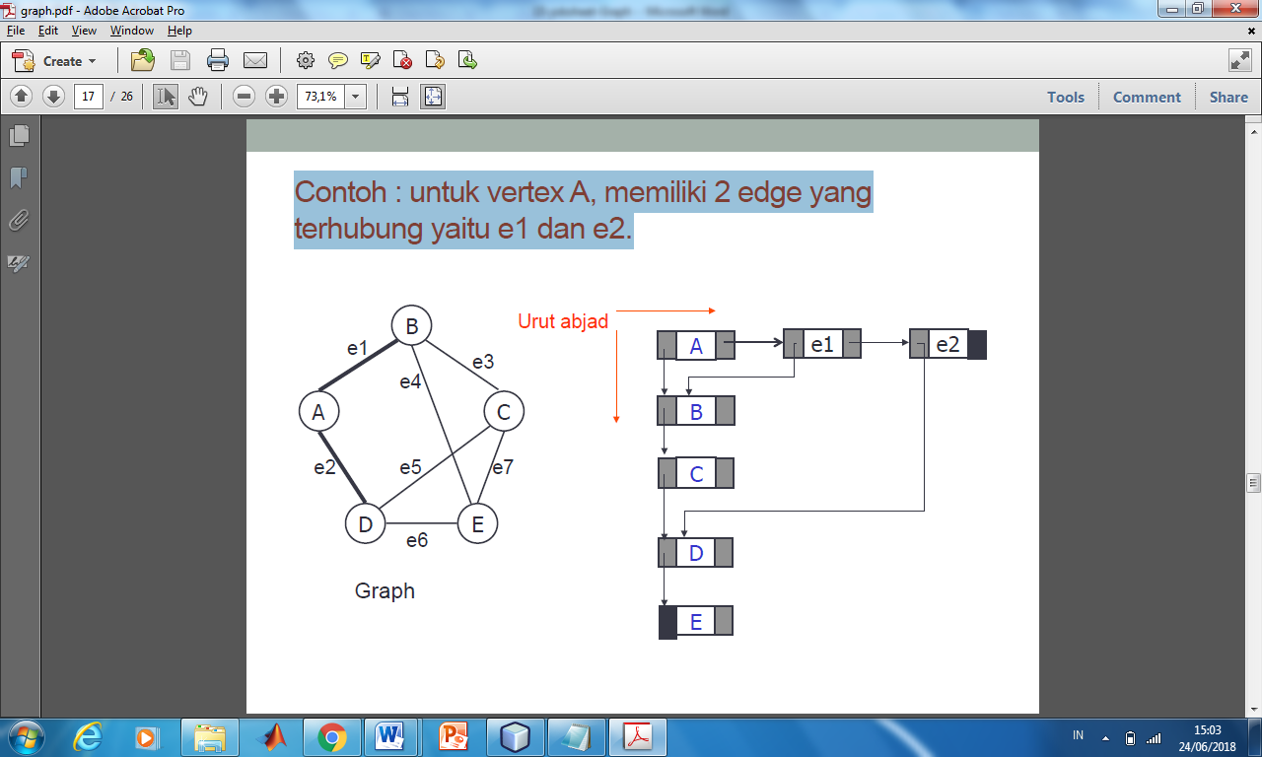
Graph Representation in Linked List
Adjency List graph undirected/ directed
Illustrated below is a vertex that has 2 pointers (vertex pointer and line pointer)

Slide 20
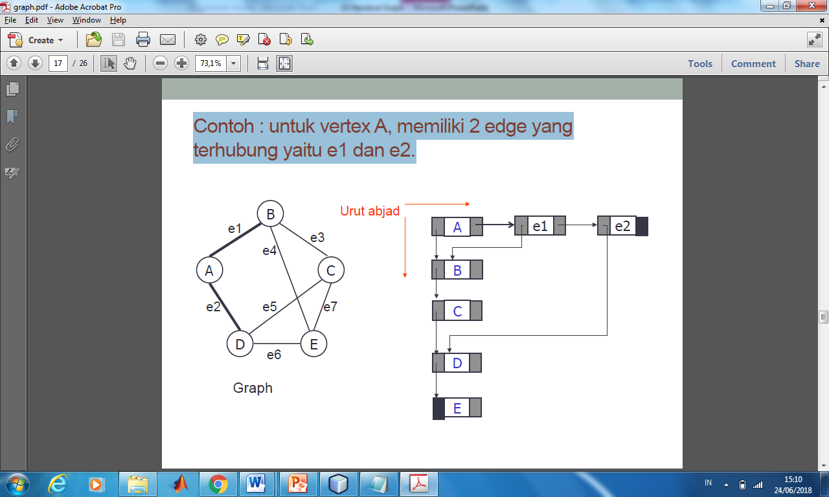
Example(1)-Adjacency Undirected Graph
For vertex A, it has 2 line that connect e₁ and e₂

Slide 21
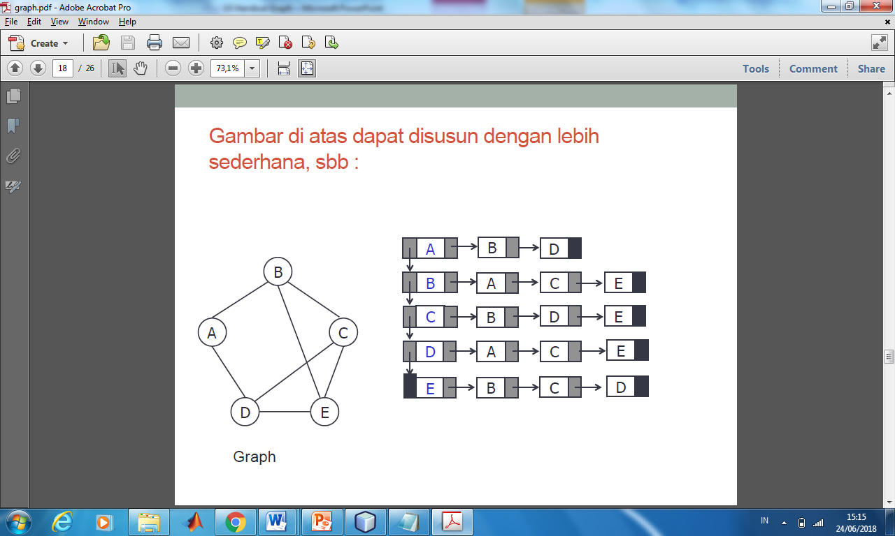
Example(1)
Simpler form of previous example

Slide 22
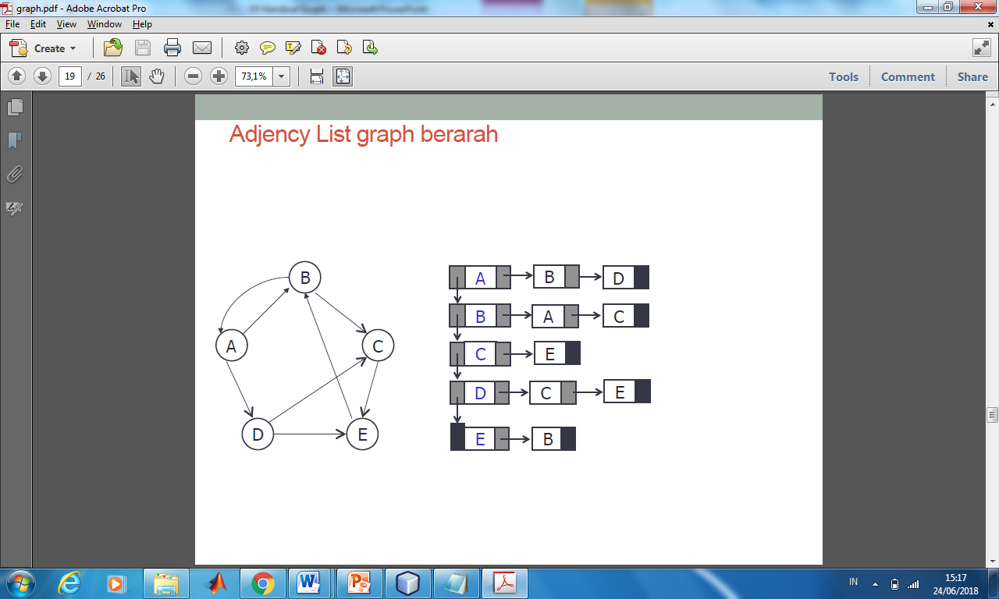
Example (2)-Adjacency Directed Graph

Slide 23
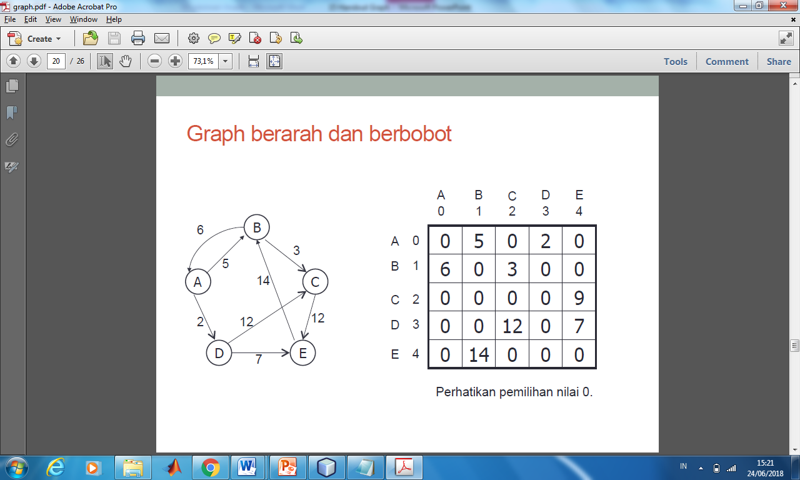
Example(3)-Directed and Weighted Graph
12

Slide 24
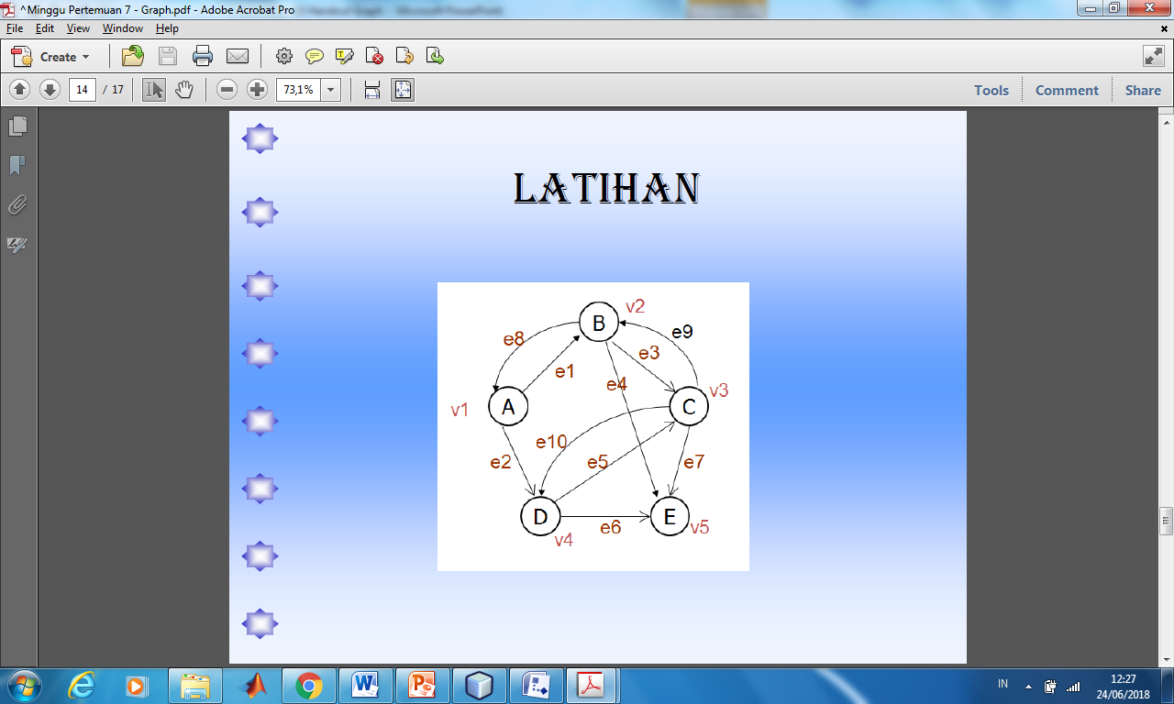
Practicum 1
Change this following Graph to matrix

Slide 25
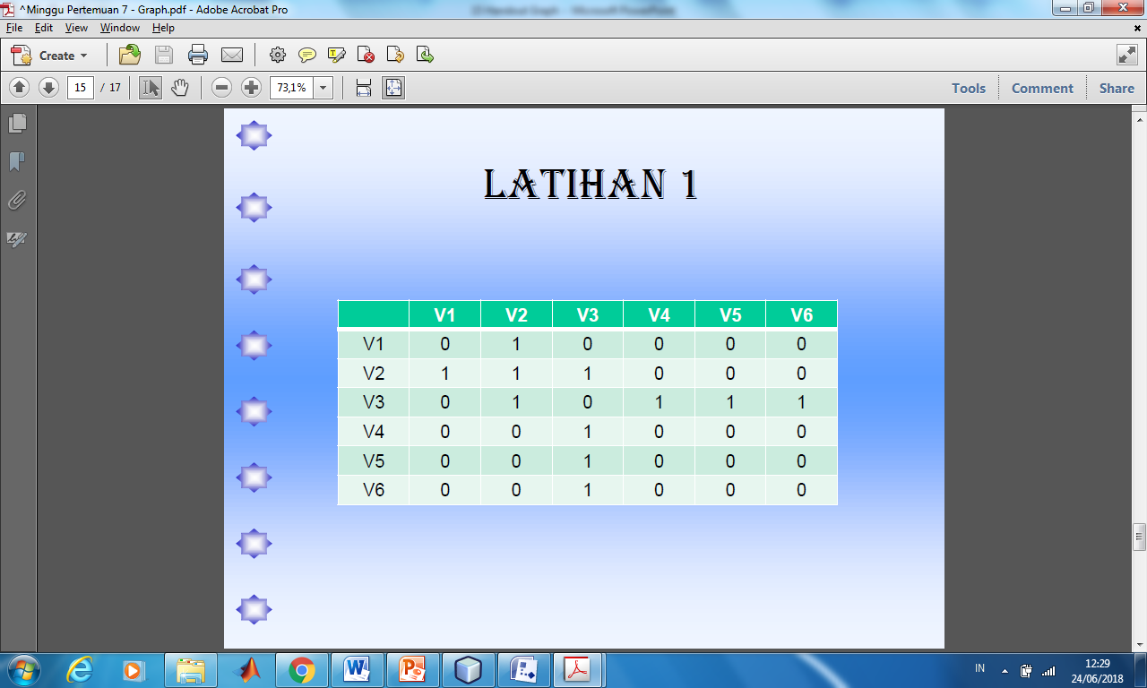
Practicum 2
Convert this matrix to Graph

Slide 26
Practicum 3
Convert this matrix to Graph
 | e₁ | e₂ | e₃ | e₄ | e₅ | e₆ | e₇ | e₈
V1 | 1 | 1 | 0 | 1 | 1 | 0 | 0 | 0
V2 | 1 | 0 | 1 | 0 | 0 | 0 | 0 | 0
V3 | 0 | 1 | 1 | 0 | 0 | 1 | 1 | 0
V4 | 0 | 0 | 0 | 1 | 0 | 1 | 0 | 1
V5 | 0 | 0 | 0 | 0 | 0 | 0 | 0 | 1

